Slide 1
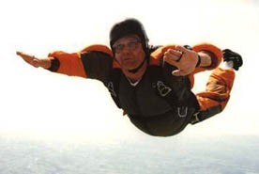
Falling
Physics 131
Lecture 3
Today: Equations of motion for constant acceleration
Fourth equation in textbook not important
Falling – Where gravity is the acceleration = -9.8 ms⁻²
All found in Young and Freedman, University Physics, Sections 2.3, 2.4, 2.5.
Notes:
Today we are going to continue our look at motion along a straight line
, deriving a few equations that are very useful when analysing motion with constant acceleration.
We’ll also look at freely falling bodies and get into some example problems. The important thing to remember is that these equations apply to motion with CONSTANT acceleration. We will be dealing with instantaneous velocity and accen in all these derivations.

Slide 2
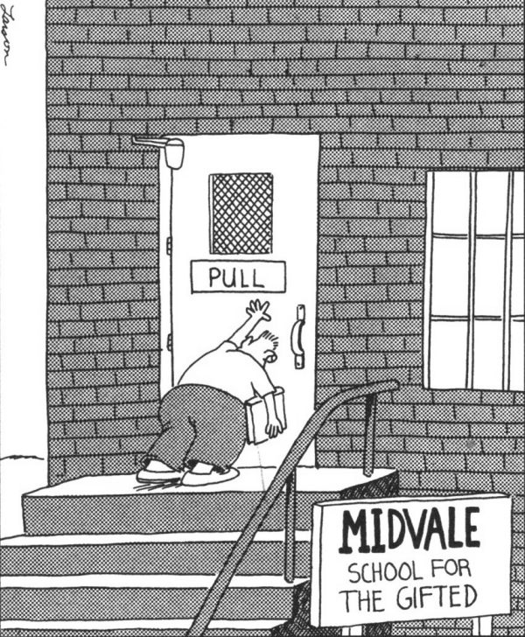

Slide 3
Review
Last lecture we looked at motion in a straight line, specifically:
Average velocity
Instantaneous velocity
Average acceleration
Instantaneous acceleration
Differentiate position equation
Differentiate velocity equation
Notes:
Last lecture we looked at motion in a straight line. We learnt :
Definition of average velocity – delta v/delta t
Definition of instantaneous velocity – the above as delta t goes to zero
Definition of average acceleration – delta v/delta t
Definition of instantaneous acceleration – the above as delta t goes to zero
How to find the above from the appropriate graph – ave vel = slope of x/t graph, inst v = slope of tangent of the x/t graph at that point, similar for accn
How to solve problems using these quantities

Slide 4

A go-kart accelerates with constant acceleration to a speed of 20 m/s from a standing start in 9 seconds.
What is it’s average velocity over the 9 seconds?
What is the acceleration?

Slide 5
Differentiation
For this course you need to know how to differentiate.
Differentiate x (position) equation – get velocity equation
Differentiate velocity equation – get acceleration equation

Slide 6
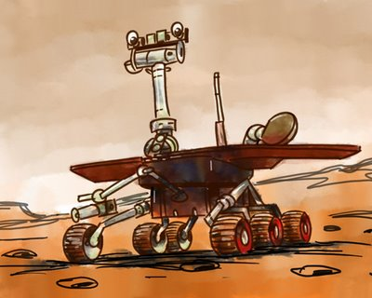
Position of Mars rover
The position of a new faster mars rover is given by:
What is its position 10 seconds after starting?
How fast is it going at time 2 seconds?

Slide 7
Derivation of the equations of motion….
2.8 in book
Notes:
Another way of deriving the first equation of motion is to simply use the average acceleration equation….and let t1=0…which is what it often is anyway….
@Talking of things falling…… Return…..

Slide 8
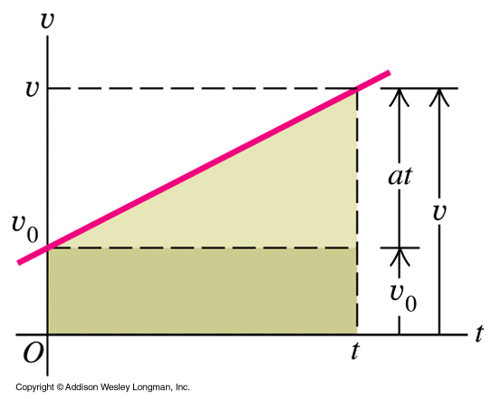
v-t graph for constant acceleration
v = v₀ + at
Straight line so average velocity will be in middle, half
Notes:
A velocity-time graph or v-t graph or velocity vs time graph for straight-line motion with constant +ve accn has a constant slope. Remember we said that the accn was equal to the slope of the tangent of the v-t line. Since accn is constant then the slope of the v-t curve must be constant and we get this sort of diagram.
Now let’s look at the simplest derivation ….one for finding final velocity. We can do this in two ways. I’ll start by looking at this overhead of velocity vs time. We start with velocity v0. What is the velocity at a later time t ? Well we have a straight-line graph. What is the equation for this ? Y=mx+c, where m is the gradient, c is the intercept. What is the gradient ? We just said that it was a. What is the intercept ? It is v0 (ie we have decided to chose velocity to be v0 at time t=0). So we have v=v0+at.
The difference between v0 and v is the distance a t on the graph (change in velocity = accn times time since accn = dv/dt).
Now let’s derive it numerically to see if we get the same. (see notes)

Slide 9
2.12 in book
Notes:
Lets look at the origin of the second equation of motion…
The definition of velocity is delta x /t

Slide 10
2.13 in book

Slide 11
What acceleration of a ball after being kicked in the air.
ALWAYS constant = -9.8 m/s²
Notes:
What is the acceleration … on a ball flying up… at the top of its flight….. Falling down to Earth

Slide 12
Ball falling
A ball falls out of a tree. Find its average velocity at between t = 0 and 2 sec.
At t = 0 x = 0 in the y direction
At t = 2 x = ½ ( -9.8) t². =19.6 m
Average velocity = Δv/Δt = 9.8 m/s
How far has it fallen at t = 3 sec
D= ½ 9.8 t²= 44.1 m

Slide 13
v-t graph for constant acceleration
v = v₀ + at
Notes:
On a v-t graph straight line for an object falling- constant acceleration…….v0 is initial velocity… v is the velocity at any time….
This graph shows where the first equation of motion comes from…..
The velocity at any final time t is equal to v0 – the initial velocity +at (reversing a=v/t)
The difference between v0 and v is the distance a t on the graph (change in velocity = accn times time since accn = dv/dt).
Can rearrange equation y=mb+b

Slide 14
Draw the graphs of x-t, v-t and a-t
Notes:
Draw graphs on board…students can fill in….

Slide 15
This ball has constant acceleration
Notes:
This ball has constant acceleration….
Draw x-t graph
V-t graph
And A-t graph
@

Slide 16
This ball has constant acceleration

Slide 17
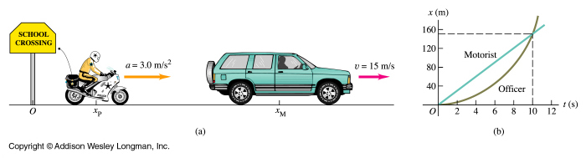
Example 2-5 Motorbike /Car
A car travelling with constant velocity of 15 m/s passes a school-crossing corner, where the speed limit is 10 m/s. Just as the car passes, a police officer on a motorbike stopped at the corner starts off in pursuit with a constant acceleration of 3.0 m/s².
Notes:
Lets do some examples……

Slide 18
Example 2-5 Motorbike/ Car (cont)
How much time elapses before the officer catches up with the car ?

Slide 19
Example 2.5 Motorbike / Car (cont)
What is the officer’s speed at this time ?
What is the total distance each vehicle has travelled at that point?

Slide 20

Freely falling bodies
Freefall = body falling under the influence of the earth’s gravitational attraction. 1Dimensional acceleration
The constant acceleration of a freely falling body is called the acceleration due to gravity, g, and has a value of about 9.8 m/s² at or near the earth’s surface.
Notes:
Now what about the case for a freely falling body ? What is a freely falling body ? We say that a freely falling body is one falling under the influence of the earth’s gravitational attraction. Here we ignore air friction. Galileo suggested that a body should fall with a downward acceleration that is constant and independent of its mass. This has been shown to be correct and indeed the value for this acceleration has been calculated (Newton’s F=Gm1m2/r squared and F=ma) and measured. The constant acceleration of a freely falling body is called the acceleration due to gravity, g, and has a value of about 9.8 m/s² at or near the earth’s surface.
G for sun is 270 m/s squared, moon, 1.6

Slide 21
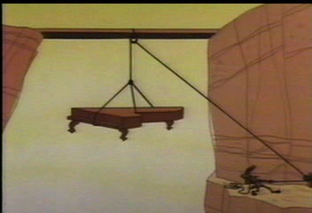
The ways gravity doesn’t work

Slide 22


Slide 23


Slide 24
If the diver hits the water at 26 m/s, how high is the diving tower?
How long is he in the air?

Slide 25

Where does “g” come from ?

Slide 26
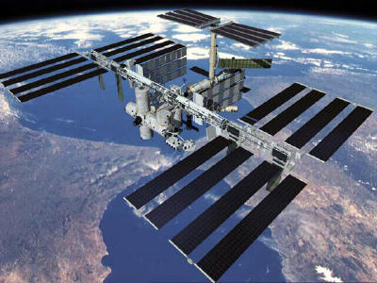
Calculate g for space station.
Notes:
Space station travelling at 27 700 km/h

Slide 27


So going down in a well inside the Earth
Does g get larger?
Smaller

Slide 28
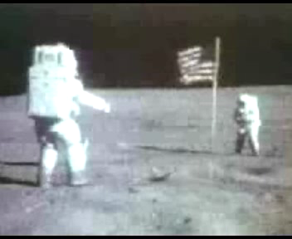
On the moon g = 1.62 ms⁻²

Slide 29

Jumping in World Cup

Slide 30
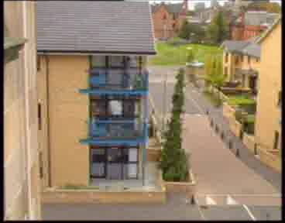

Slide 31
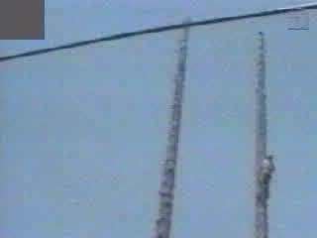

Slide 32
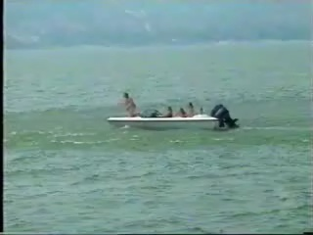

Slide 33
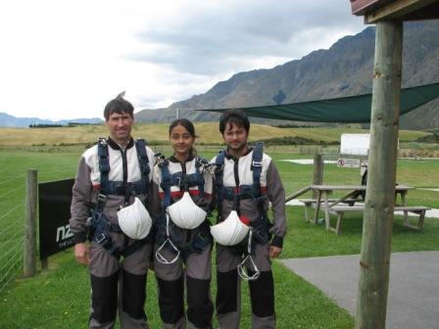
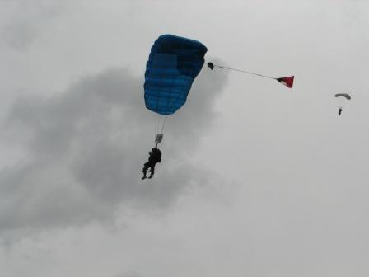
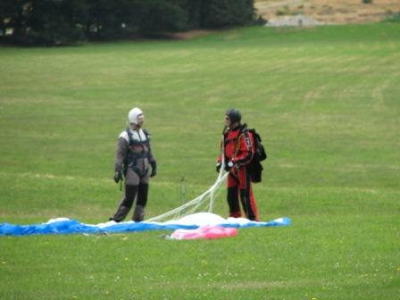
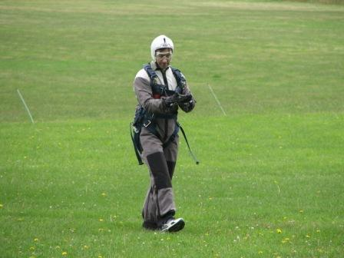
Falling from 6 km

Slide 34
Example: Distance falling
A ball was dropped off the top of the library. It was measured to take 2.0 seconds to hit the ground. How far off the ground was it dropped?
Know
t = 2 sec
a=g
V0=0
x = ?
x= v₀t + ½ at²= ½ x 9.8 x 4 = 19.6 m

Slide 35

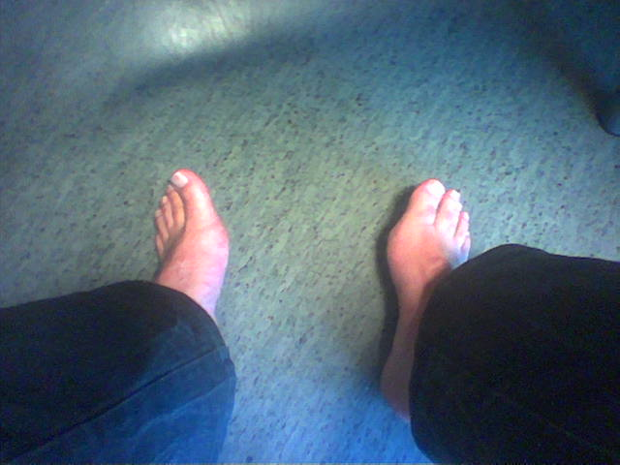
Falling brick
A workman was hit on the head by a falling brick. It was fortunate that he was wearing a helmet, however the brick then fell towards his uncovered foot.
Assume that the brick has 0 vertical velocity after it hits the helmet, and it falls 1.75 m, unimpeded to the man’s foot. Also that nerve impulses travel through the body at 70 m/s.
How much time will the foot have, to move out of the way, once the message has reached it.

Slide 36
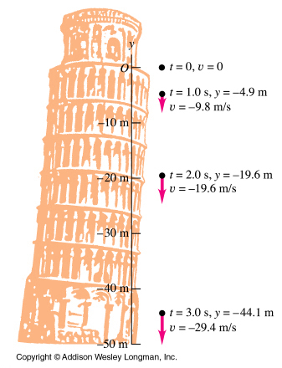
Example 2.6 Freely falling bodies
2.6 A one-euro coin is dropped from the Leaning Tower of Pisa. It starts from rest and falls freely. Compute its position and velocity after 1.0 and 2.0 and 3.0 s
Notes:
A one-euro coin is dropped from the Leaning Tower of Pisa. It starts from rest and falls freely. Compute its position and velocity after 1.0 and 2.0 s

Slide 37
A ball is thrown up on top of a building.
What is its initial vertical velocity v_{0y}?
What is its velocity as it falls back to the top of the building?

Slide 38
A ball is thrown up on top of a building (cont)
What is its velocity when it hits the ground?
How long does it take to hit the ground?

Slide 39
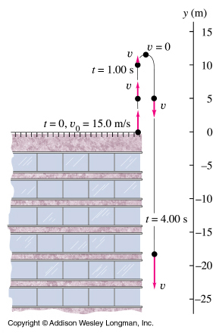
Example 2.7 Up and Down Motion in Free Fall
You throw a ball vertically upward at 15 m/s from the roof.
On its way down it misses the building.
Find
a) The position and velocity of the ball 1 and 4 seconds after leaving your hand.
Notes:
The position equation is …
And the velocity equation is…

Slide 40
Example 2.8 Up and Down Motion in Free Fall
Find the time when the ball is 5 m below the roof.

Slide 41
Ball on Mars
A ball is thrown up and it follows the equation
v = 20 - 4t (m/s) compare with v = v₀+at
What is the initial velocity? What would be the velocity after 6 seconds?
v=20m/s-24m/s = -4 m/s
What is the acceleration for the ball?
Compare with v = v₀+at So a = -4 m/s²
What is the time in the “air”?
Double the time to v = 0ms⁻¹. 0ms⁻¹=20ms⁻¹-4ms⁻²t So 2*5s = 10 s.

Slide 42
Review
All found in University Physics, 2.4 and 2.5

